Slide 1

ODK @ LSHTM
Dr Chrissy h Roberts and Dr Michael Marks
London School of Hygiene & Tropical Medicine
opendatakit.lshtm.ac.uk
odk@lshtm.ac.uk

Slide 2
What is ODK @ LSHTM
ODK is a suite of tools to enable electronic data collection from anywhere in the world
@LSHTM we have setup a secure encrypted server for researchers and students
Launched in September 2015

Slide 3
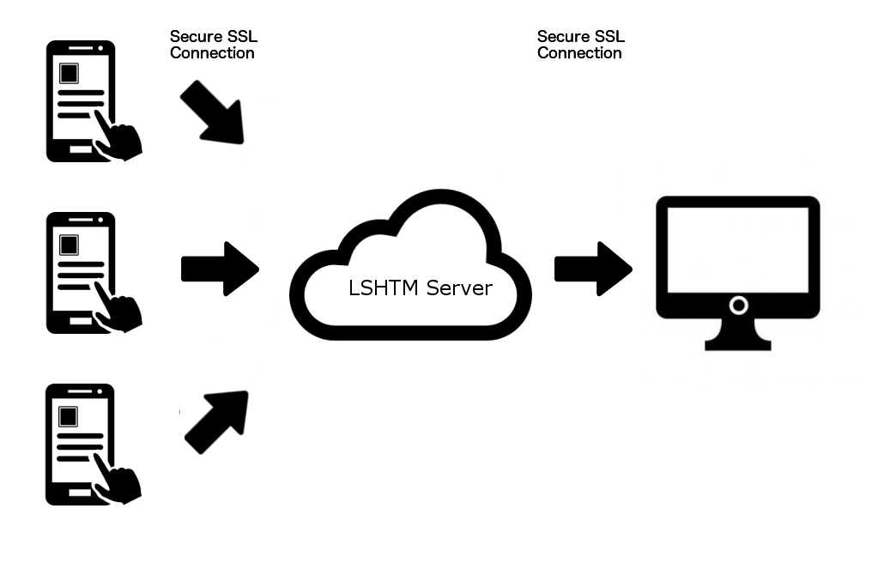
Overview

Slide 4
I like paper forms – why do I need ODK?

Slide 5
Problems with paper forms
Hard to read
Don’t have to be fully completed
Allow incorrect data entry
Need to be copied over to a computer
Get lost/wet/ripped

Slide 6
Advantages of electronic data capture
Improve Data Accuracy
Improve Data Completeness
Improve Speed of Analysis
Prompts user at every stage what to do next

Slide 7
How to use ODK@LSHTM
Request an account
Install
ODK Collect
Build Data “Forms”
Upload forms to device
Start collecting data

Slide 8
ODK @ LSHTM Server Request
Complete Server Request Form
Available at opendatakit.lshtm.ac.uk
Email : ODK@lshtm.ac.uk
Server normally setup in < 1 week

Slide 9
ODK @ LSHTM Device Pool
We have a central pool of devices
22 NEXUS 7 TABLETS
13 NEXUS 5 PHONES
25 10-20 mAh POWERBANKS
3 3G WIFI BROADCAST DONGLES
These can be requested for short/medium term loan
The Device Request form is available at opendatakit.lshtm.ac.uk

Slide 10
How to use ODK@LSHTM
Request an account
Install
ODK Collect
Build Data “Forms”
Upload forms to device
Start collecting data

Slide 11
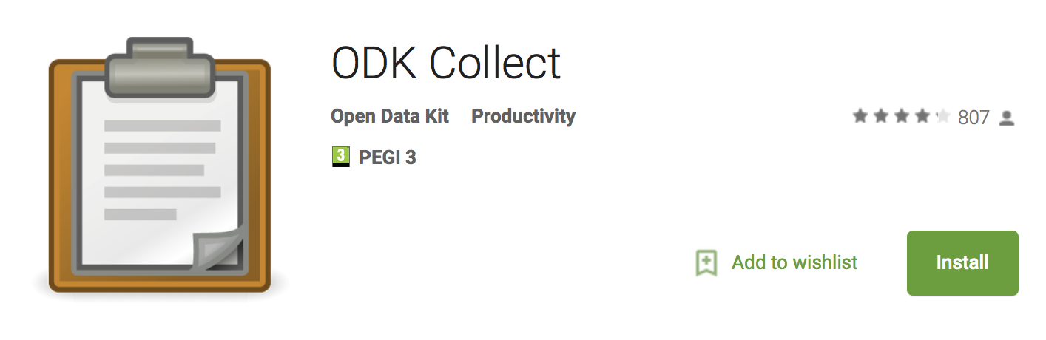

Install ODK Collect

Slide 12
Please fill in the Pizza survey on the devices in the room.

Slide 13
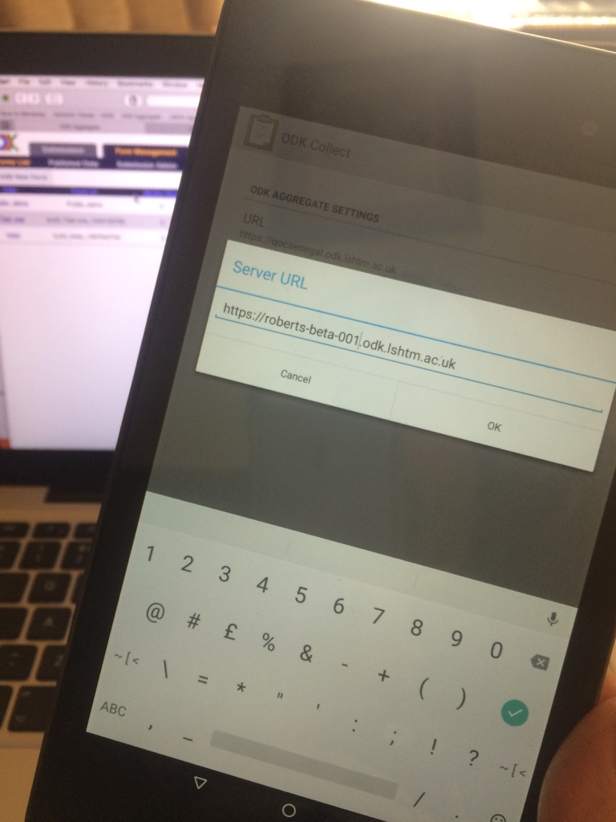
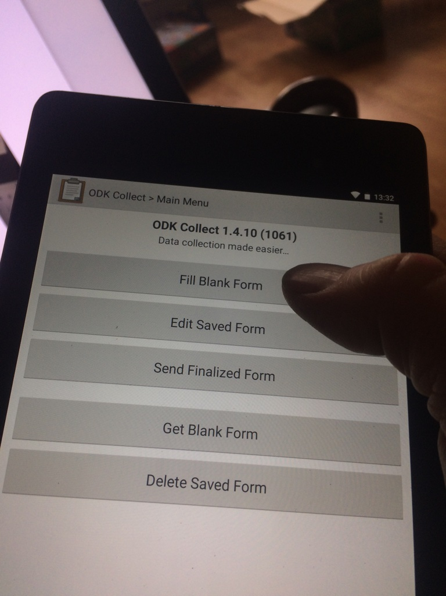
Start Collecting Data

Slide 14
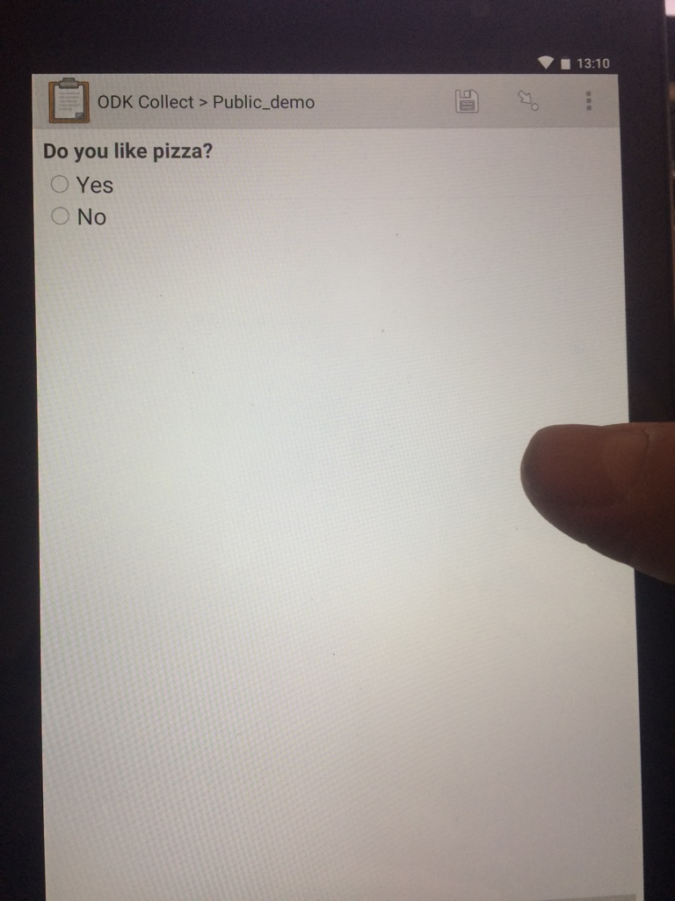
Start Collecting Data

Slide 15
How to use ODK@LSHTM
Request an account
Install
ODK Collect
Build Data “Forms”
Upload forms to device
Start collecting data

Slide 16

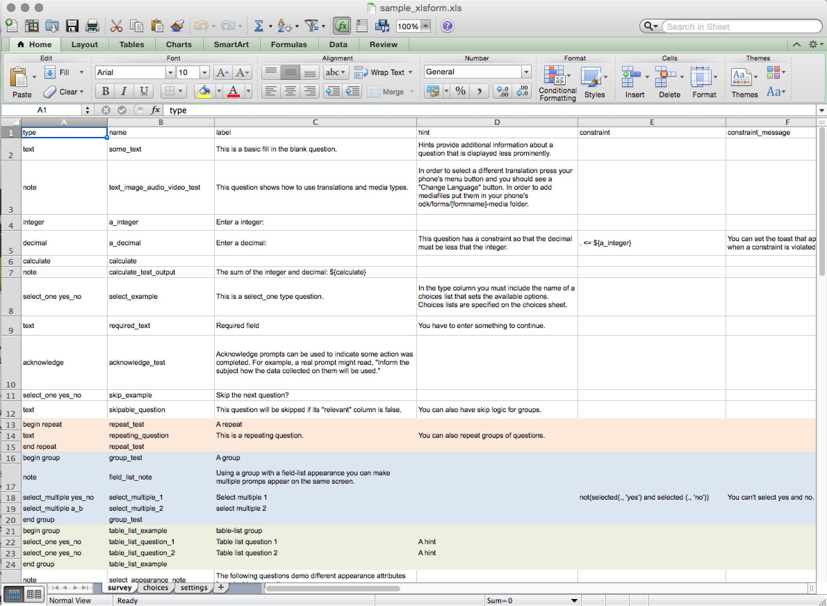
Build a data collection ‘form’
Recommended
Option 1 : XLS Form Design

Slide 17

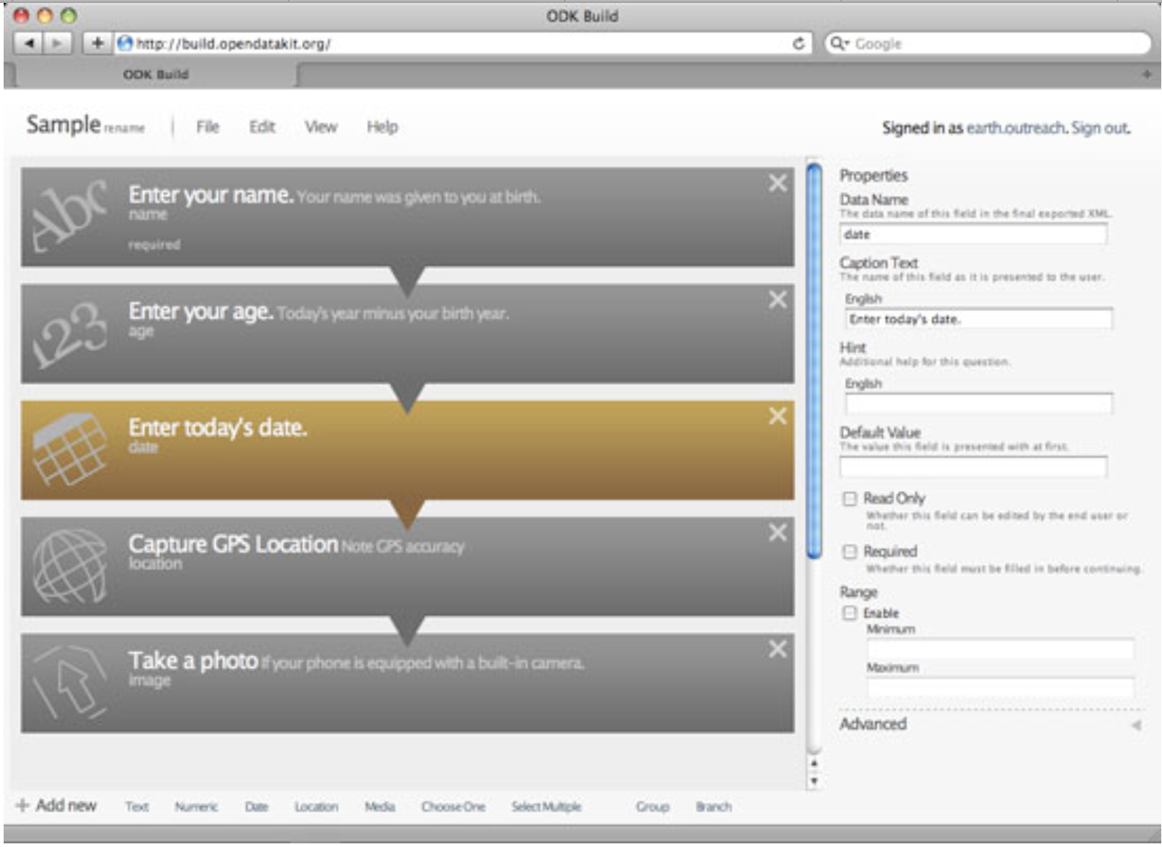
Build a data collection ‘form’
Not Recommended
Option 2 : ODK Build

Slide 18
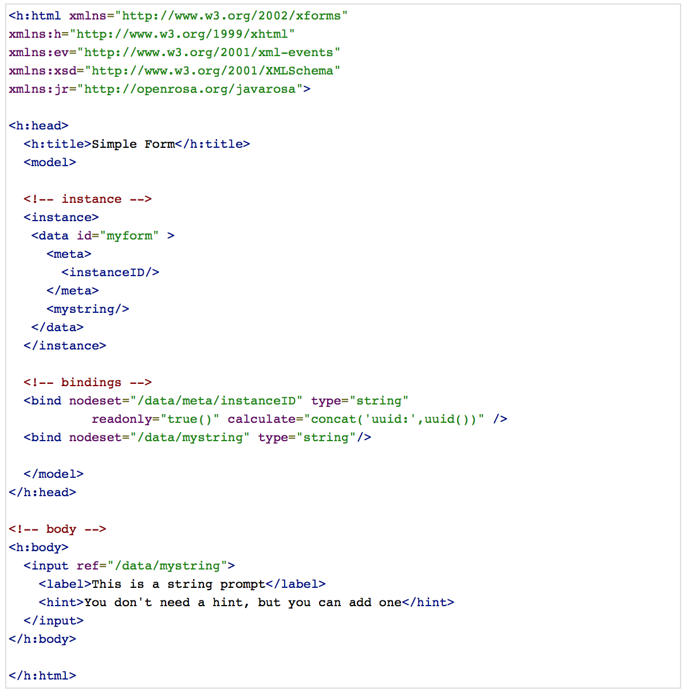
Build a data collection ‘form’
Not Recommended
Option 3 : XML Editing

Slide 19
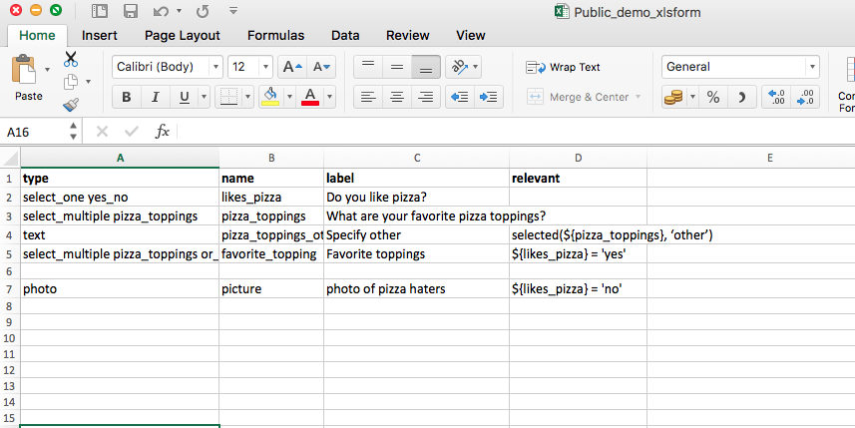
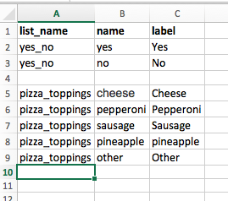
Design a form in Excel

Slide 20
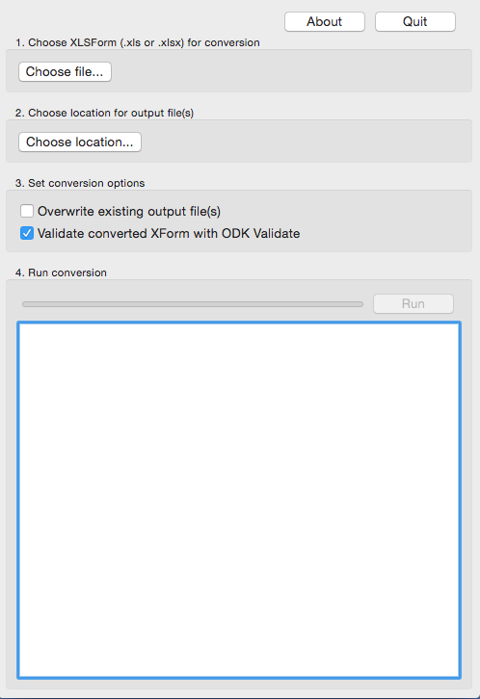
Make XML file with XLSFORM offline

Slide 21
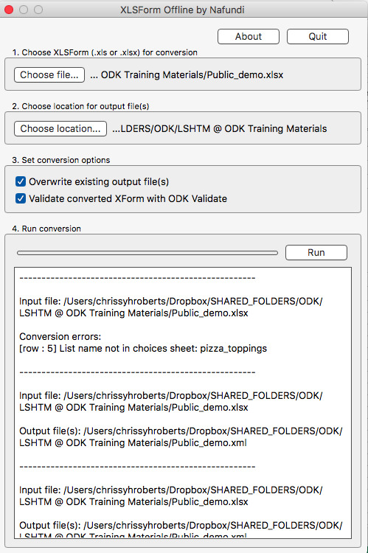
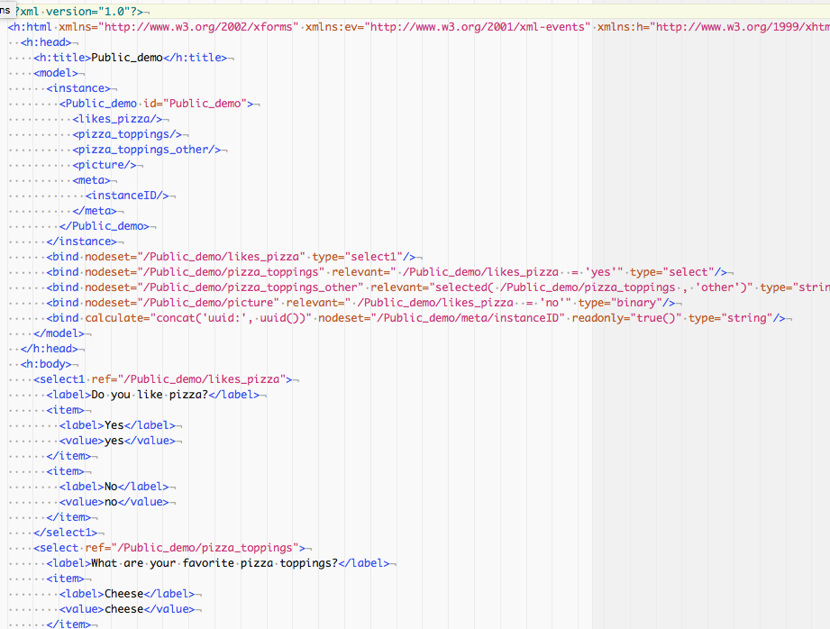
Make XML file with XLSFORM offline

Slide 22
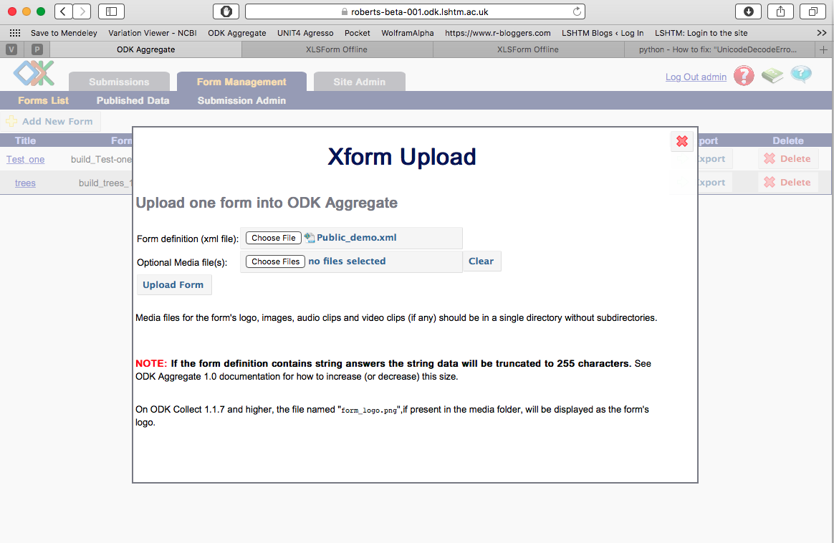
Upload XML file to server

Slide 23
How to use ODK@LSHTM
Request an account
Install
ODK Collect
Build Data “Forms”
Upload forms to device
Start collecting data

Slide 24
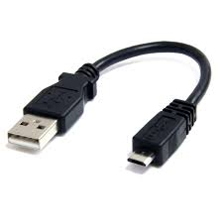
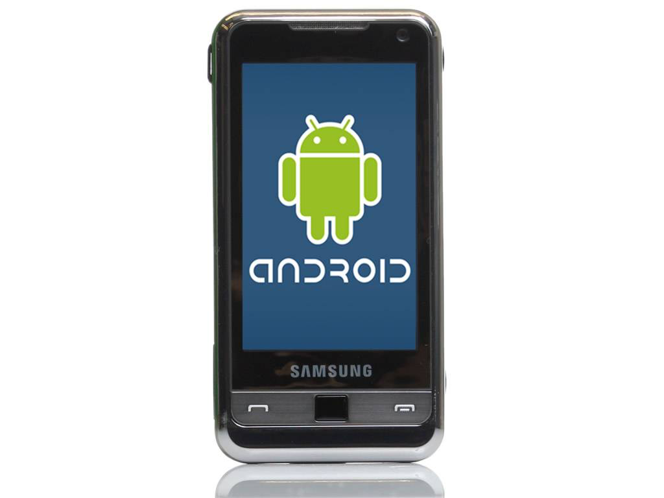


Upload forms to device
/odk/forms

Slide 25
Connect Android device to server

Slide 26
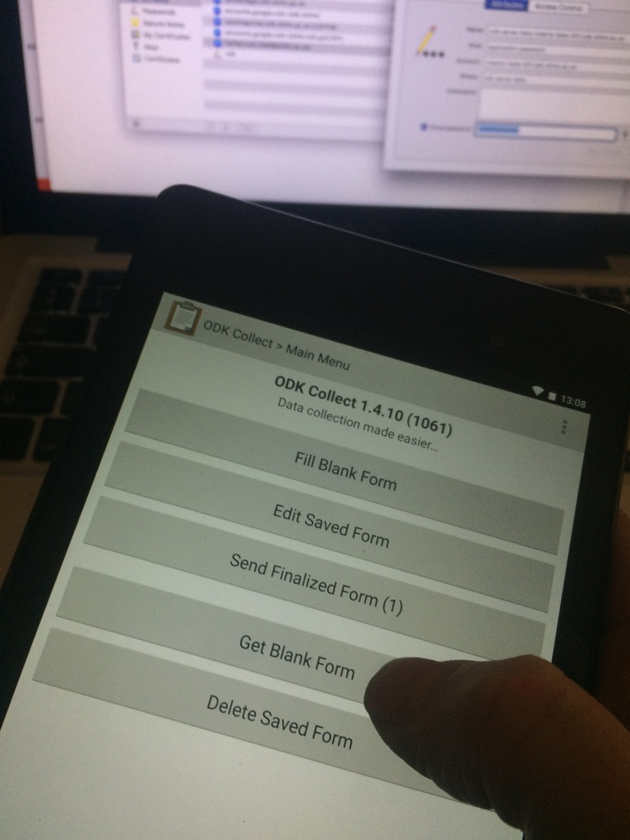
Download the blank form (XML file)

Slide 27
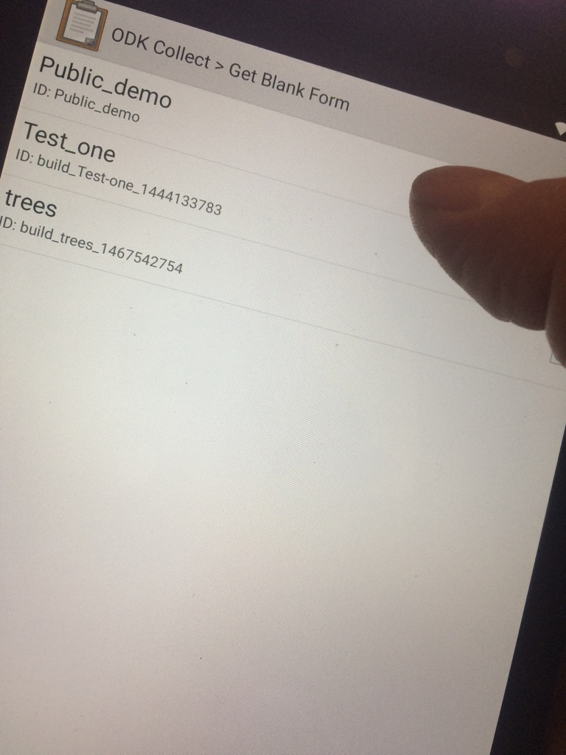
Download the blank form (XML file)

Slide 28
How to use ODK@LSHTM
Request an account
Install
ODK Collect
Build Data “Forms”
Upload forms to device
Start collecting data

Slide 29
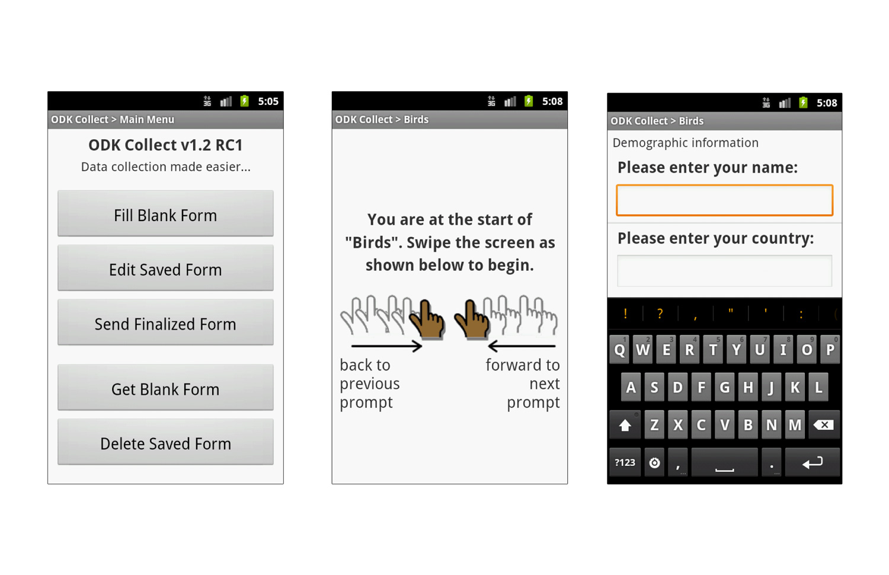
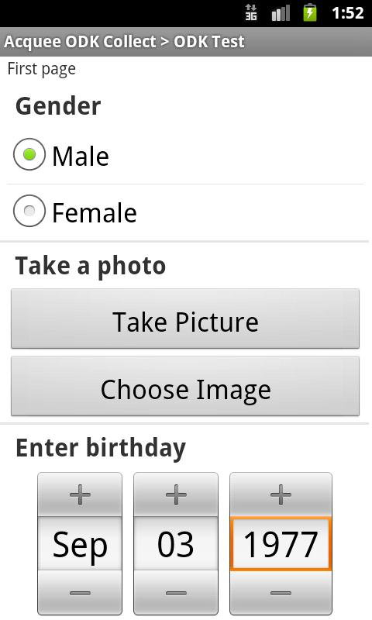

Slide 30
Start Collecting Data

Slide 31
Start Collecting Data

Slide 32
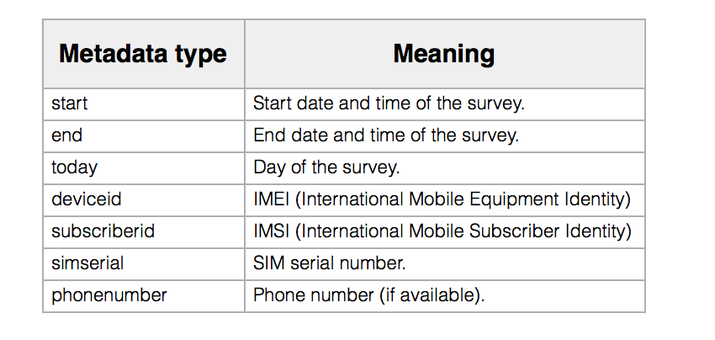
Metadata

Slide 33
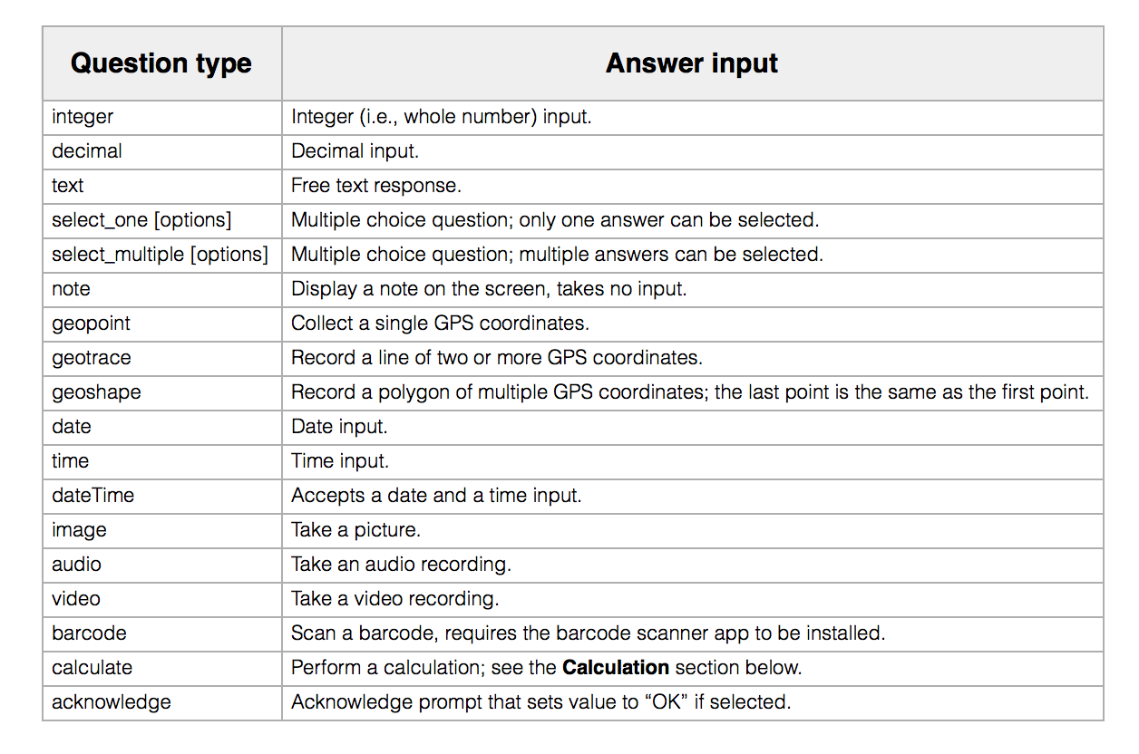
What kinds of data can be collected?

Slide 34
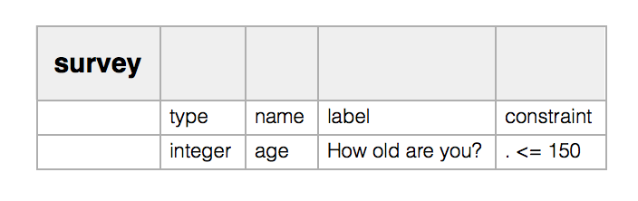
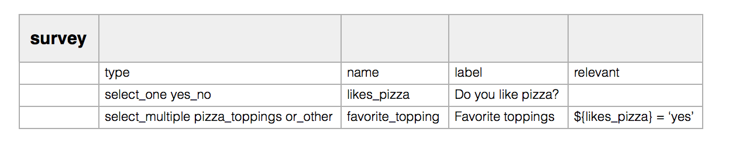
Constraint & Relevancy
Constraint*
Relevance
*Includes Regular expressions!!!

Slide 35
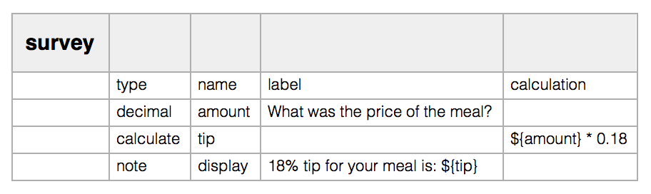
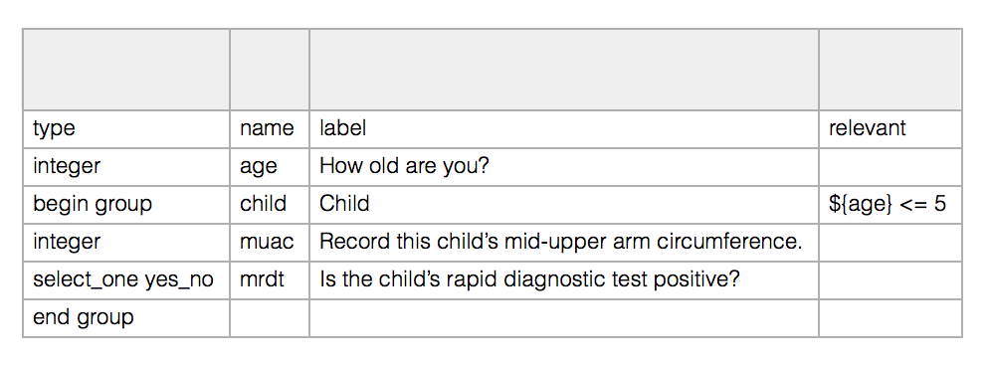
Calculation, Grouping, Skipping
Calculation
Grouping & Skipping

Slide 36
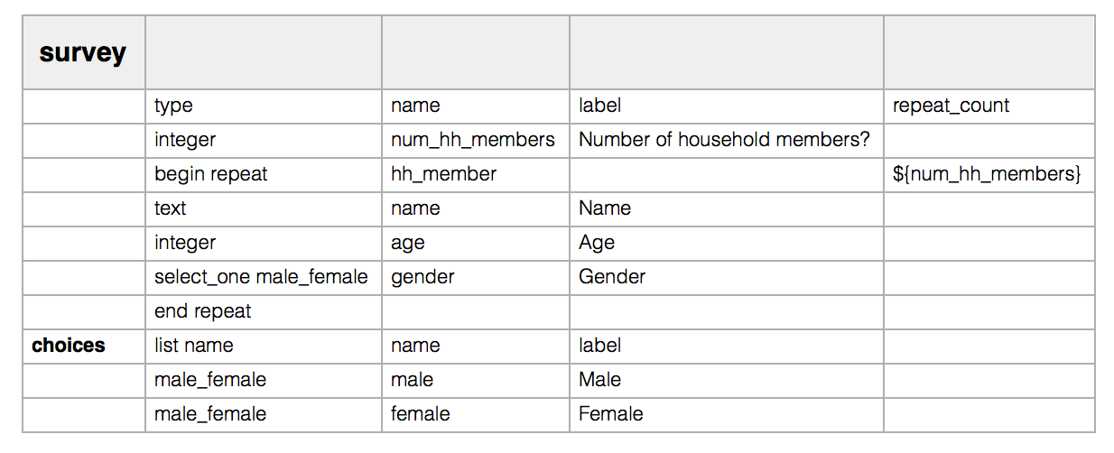
Repeats

Slide 37
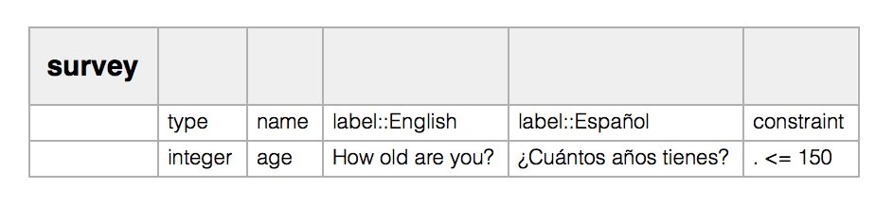
Multiple Language Support
Open Localization project : Help translate ODK

Slide 38
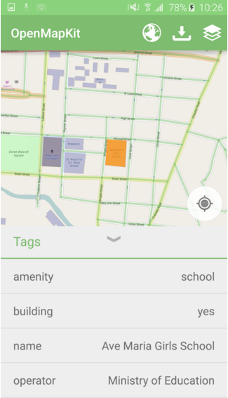
Annotate Maps
OpenMapKit plug-in
Allows you to annotate maps in the field
Export data to a GIS package of your choice

Slide 39
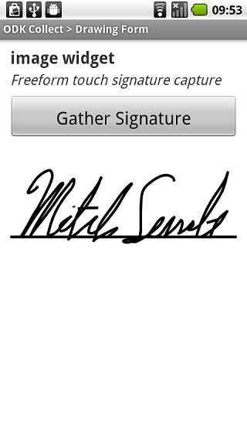
Data from sensors
(wifi/bluetooth)
E-consent
Barcode scanning via camera
Environment sensors
Point-of-care tests
Calls to 3rd party apps
Fill data from 3rd party apps

Slide 40

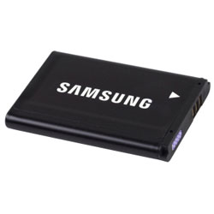
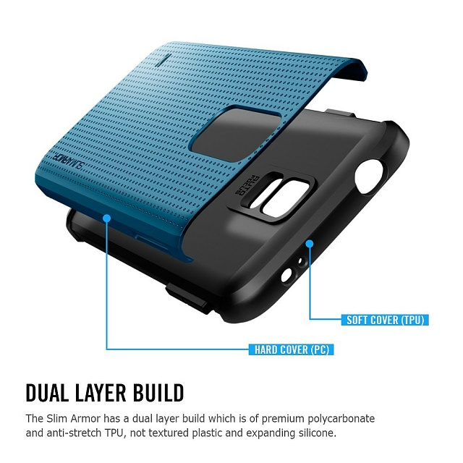
Out in the field : Collecting
Don’t need
mobile signal
data signal
WIFI
Do need
Power
Armour
Spare batteries

Slide 41

Out in the field : Uploading
Wifi/Mobile Data connection
Upload can be done at the end of each day/week/trip
Single click upload
All your data gets sent to ODK@LSHTM
Security
ODK@LSHTM is a fully encrypted (SSL) server with a direct data link to your phone

Slide 42
Standard security
Password protected
Password protected
Password protected

Slide 43
Advanced security for NHS/Clinical Trials etc
Two stage encryption with gpg protocols
Encrypted data on server
Decryption on local machine
Only with USB key containing
gpg decryption key
Encryption on phone
with gpg encryption key
Trialling in the Whittington NHS Trust

Slide 44
Getting your data back
Data can be exported from ODK@LSHTM in text file formats (CSV, TDT, TXT) or XML
Media exported with filename links to forms
Compatible with R, STATA, MATLAB, EXCEL etc.

Slide 45
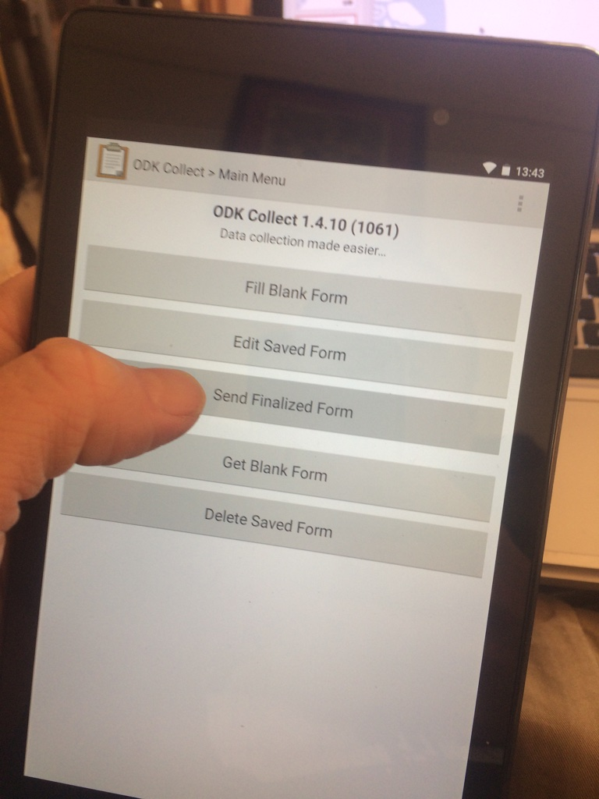
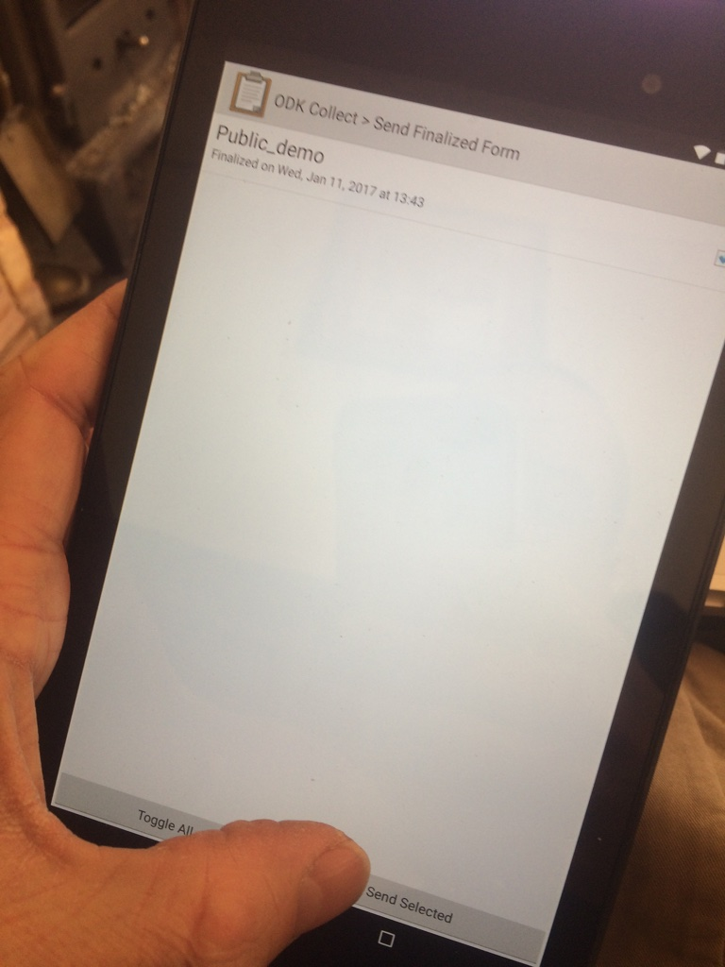
Pizza Survey Results

Slide 46
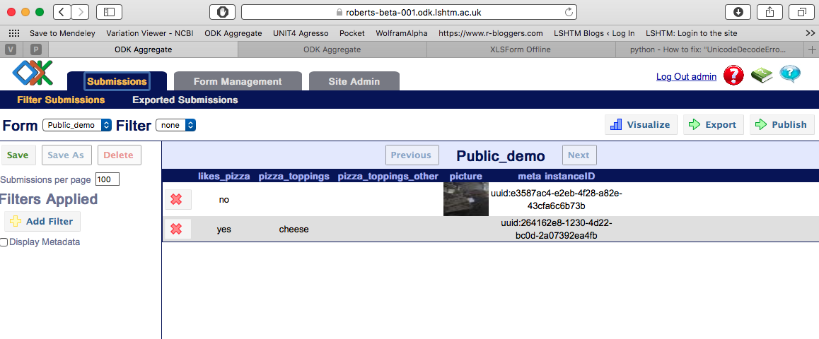
Data on Server
Simple Analysis/Report
Data instances (one line per form submission)

Slide 47
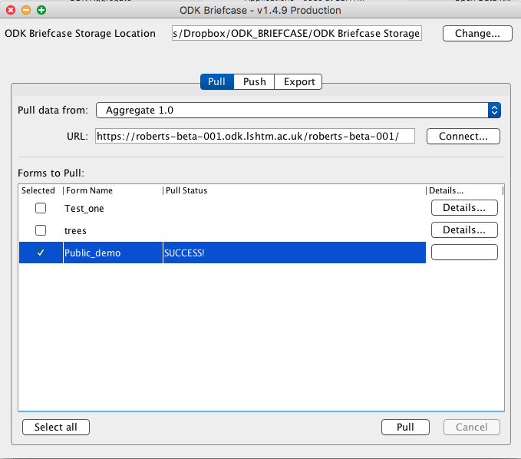

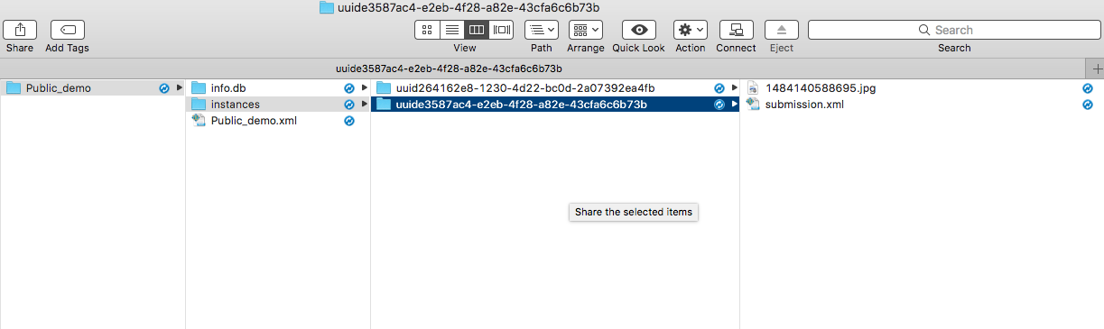
Use ODK briefcase to pull records
Copies all forms and media
to a local computer
1484140588695.jpg
This guy hates pizza ->

Slide 48
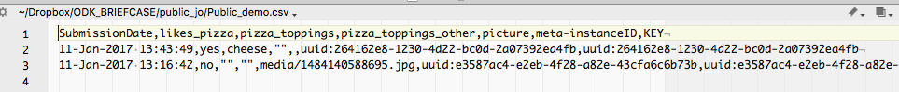
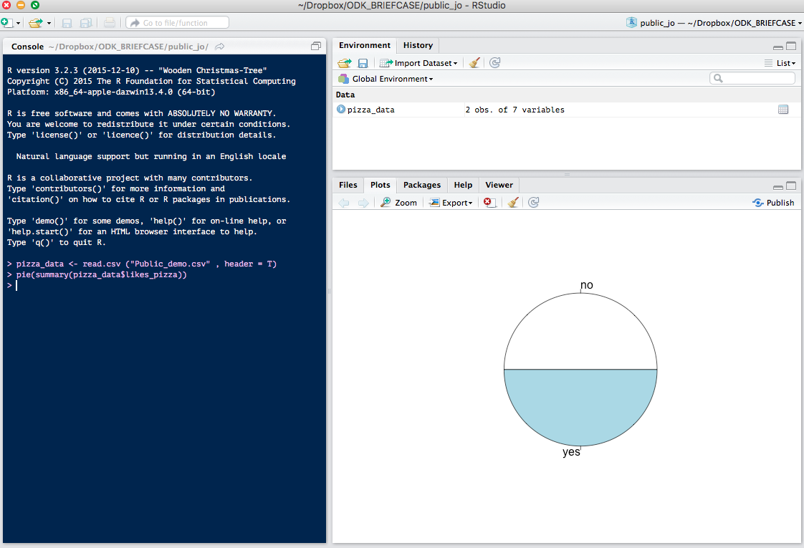
Export common CSV file format

Slide 49
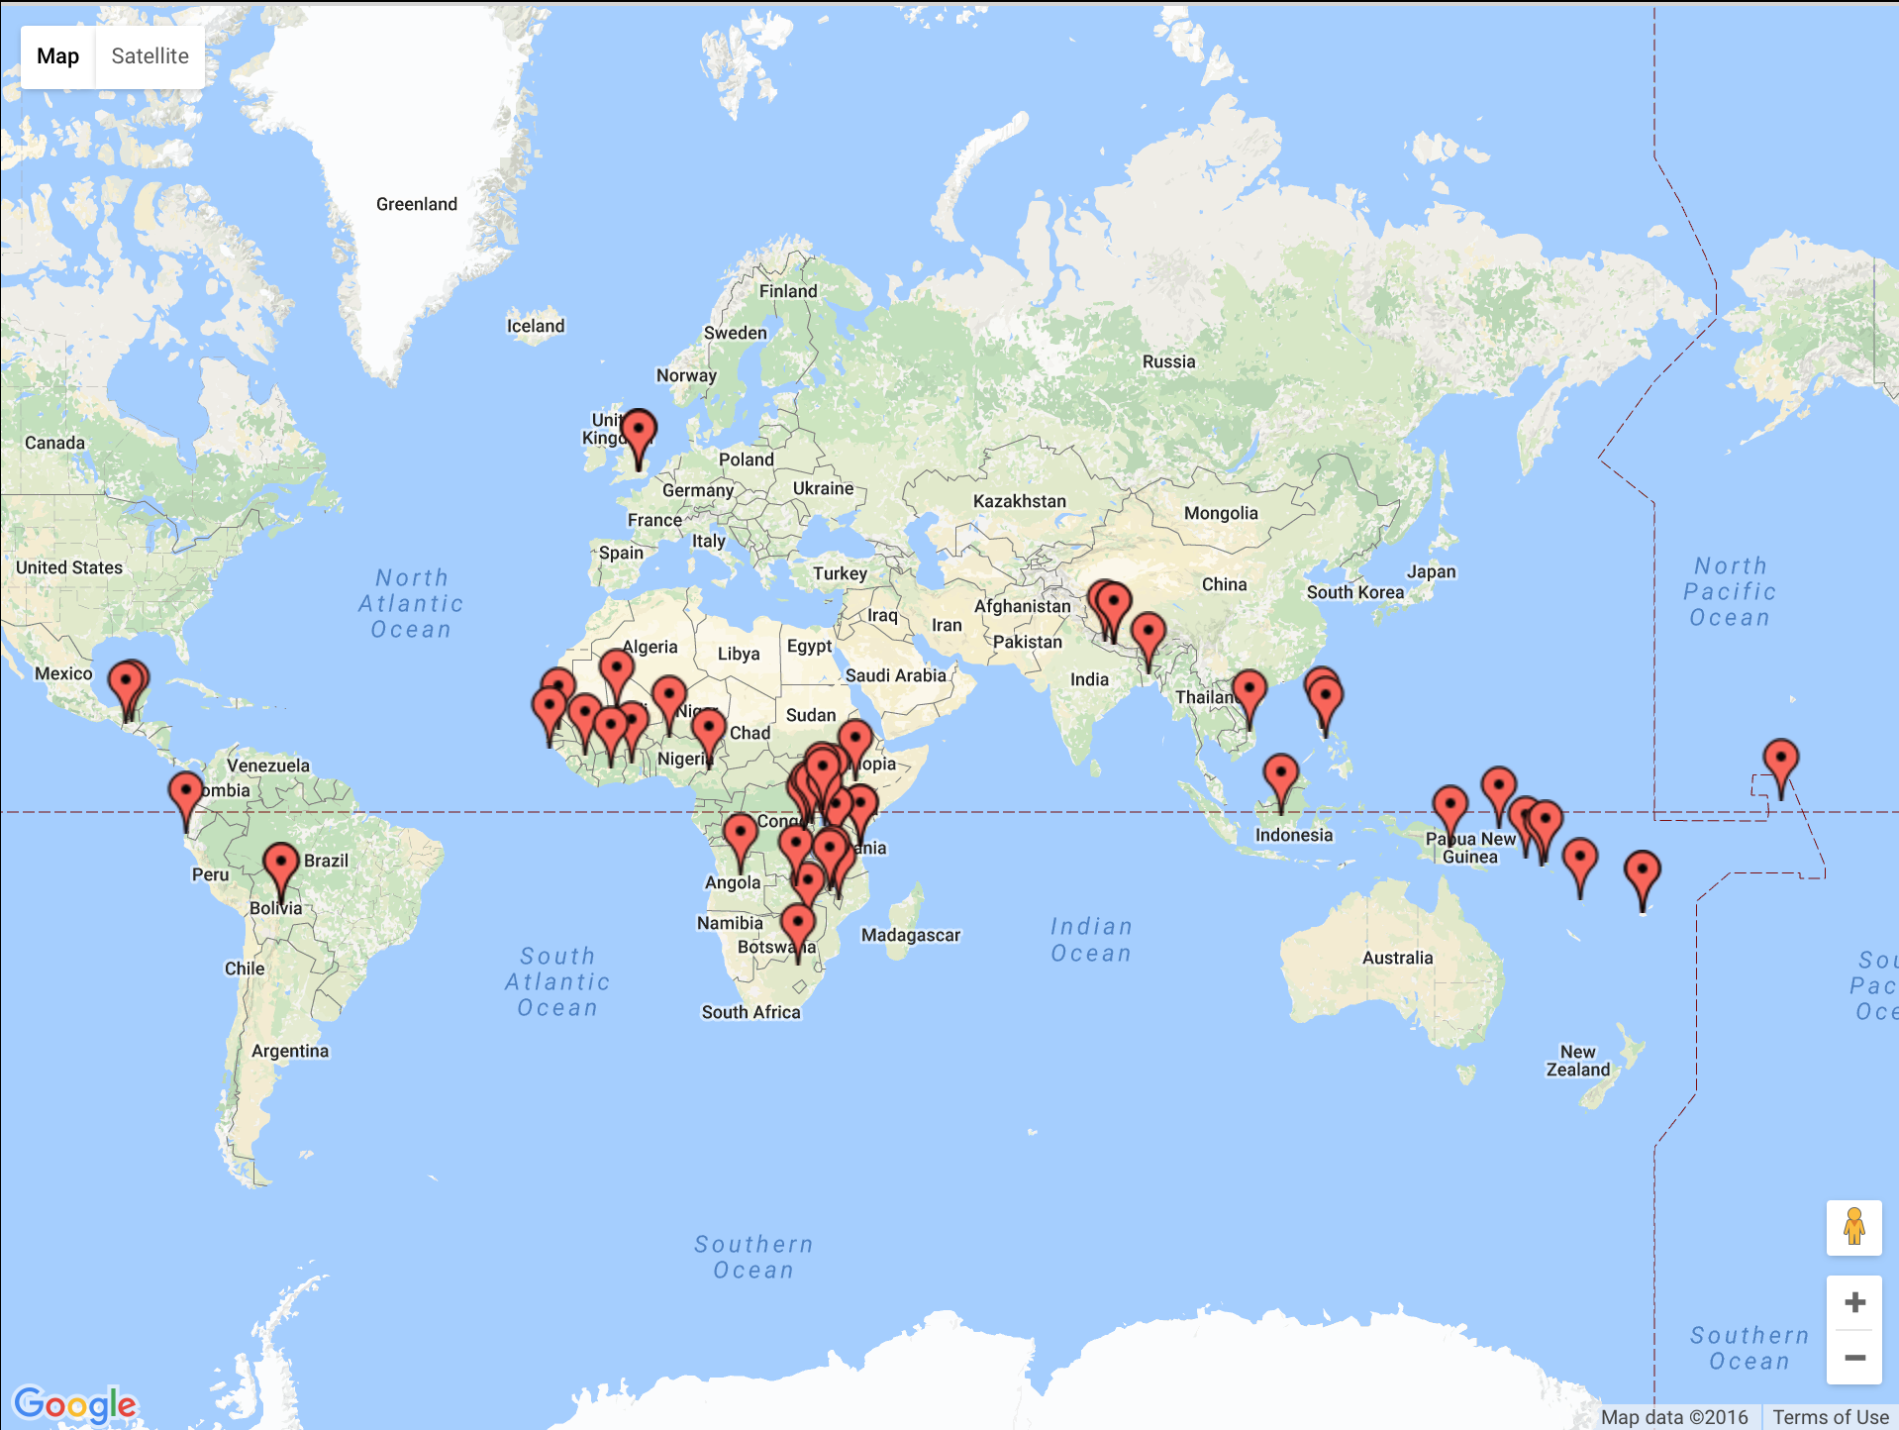

Slide 52
How can I use ODK
Complete the request form:
http://opendatakit.lshtm.ac.uk/contact-us/
Email ODK@lshtm.ac.uk
We will setup a password-protected secure server just for your project
We will run tutorials on how to create ODK questionnaires

